Slide 1

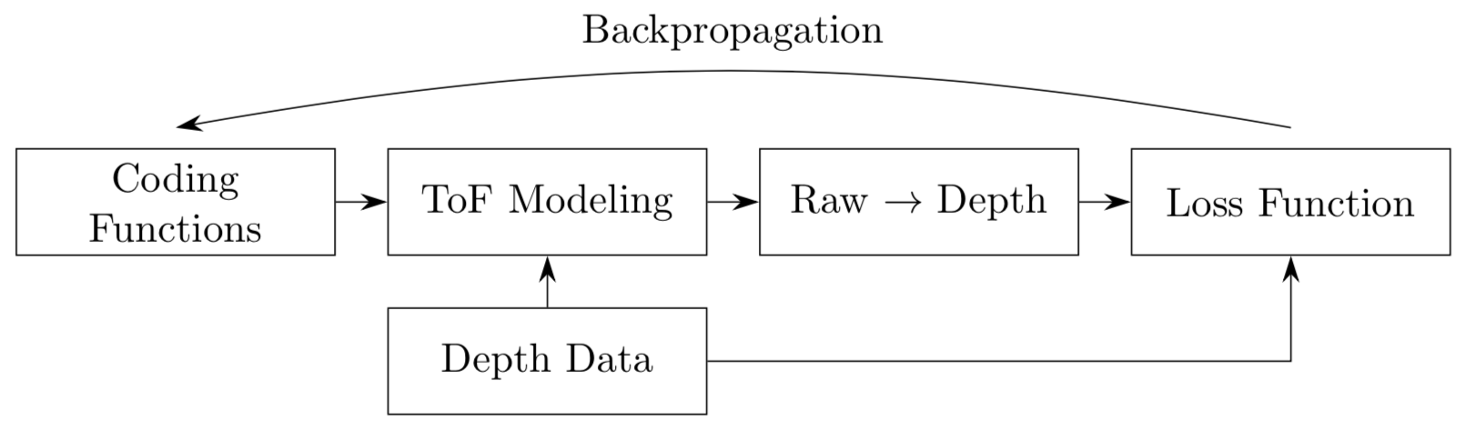
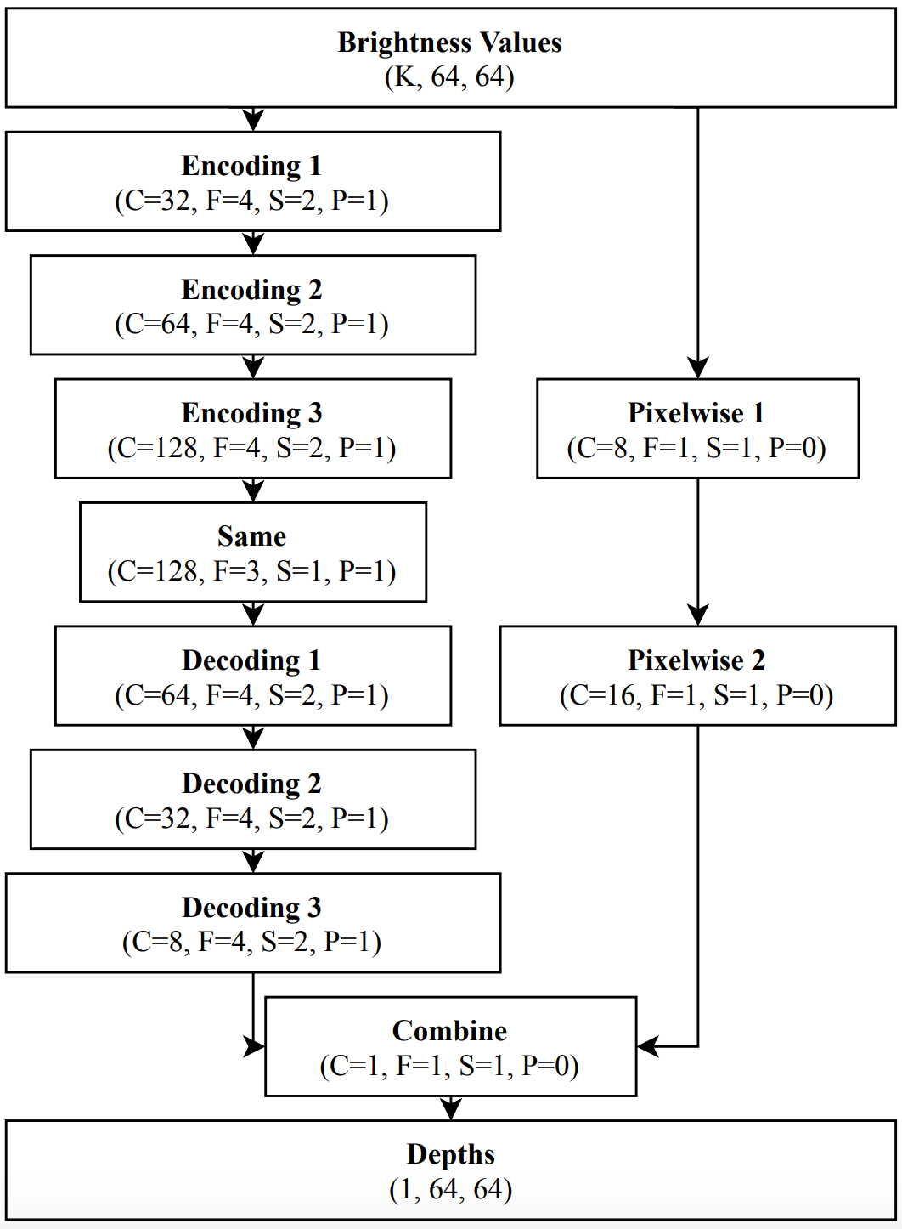
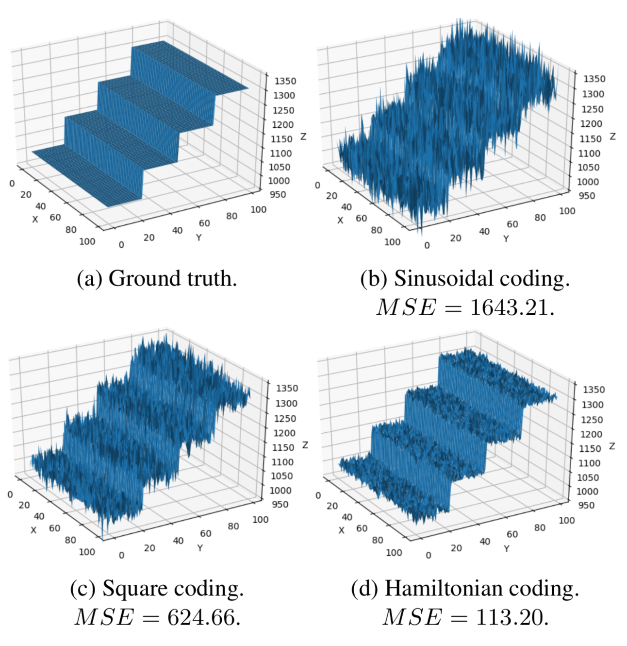
Time-of-Flight Coding Function Optimization
Jonas Messner, Nicholas Gaudio, {messnerj, nsgaudio}@stanford.edu
Department of Electrical Engineering, Stanford University
BACKGROUND and MOTIVATION
1. Methods
Continuous-Wave Time-of-Flight System Overview
Non-Neural Network Optimization Diagram
Neural Network Architecture
Received Light
Sensor Demodulation Function
Some BS 1
Some BS 2
Some BS 3
Cross-Correlation
Convolutional Neural Network Optimization Diagram
2. DATASET
Coding Curves
Some BS 1
Some BS 2
Some BS 3
3. RESULTS and DISCUSSION
Recovered Depth Maps
Depth Precision
Coding Curve Length
REFERENCES
FUTURE WORK
[1] R. Ferriere, J. Cussey, and J. Dudley. Time-of-flight range detection using low-frequency intensity modulation of a cw laser diode: Application to fiber length measurement. Optical Engineering - OPT ENG, 47, 09 2008.
[2] R. Grootjans, W. van der Tempel, D. Van, C. De Tandt, and M. Kuijk. Improved modulation techniques for time-of-flight ranging cameras using pseudo random binary sequences. Proc. IEEE LEOS Benelux Chapter, 2006.
[3] M. Gupta, A. Velten, S. K. Nayar, and E. Breitbach. What are optimal coding functions for time-of-flight imaging? ACM Trans. Graph., 37(2):13:1–13:18, Feb. 2018.
[4] F. Gutierrez-Barragan, S. A. Reza, A. Velten, and M. Gupta. Practical coding function design for time-of-flight imaging. To appear in CVPR 2019, 2019.
[5] B. Hariharan, P. A. Arbelaez, R. B. Girshick, and J. Malik. Hypercolumns for object segmentation and fine-grained localization. CoRR, abs/1411.5752, 2014.
[6] A. Kolb, E. Barth, R. Koch, and R. Larsen. Time-of-flight cameras in computer graphics. Computer Graphics Forum, 29(1):141–159, 2010.
[7] R. Lange. 3D Time-of-Flight Distance Measurement with Custom Solid-State Image Sensors in CMOS/CCD-Technology. PhD thesis, University Siegen, 2000.
[8] P. Liu and E. Y. Lam. Image reconstruction using deep learning. CoRR, abs/1809.10410, 2018.
[9] P. K. Nathan Silberman, Derek Hoiem and R. Fergus. Indoor segmentation and support inference from rgbd images. In ECCV, 2012.
[10] A. Paszke, S. Gross, S. Chintala, G. Chanan, E. Yang, Z. DeVito, Z. Lin, A. Desmaison, L. Antiga, and A. Lerer. Automatic differentiation in PyTorch. In NIPS Autodiff Workshop, 2017.
[11] A. Payne, A. A Dorrington, and M. Cree. Illumination waveform optimization for time-of-flight range imaging cameras. Proceedings of SPIE - The International Society for Optical Engineering, 8085, 06 2011.
[12] M. Ravanelli and Y. Bengio. Speaker recognition from raw waveform with sincnet. In 2018 IEEE Spoken Language Technology Workshop, SLT 2018, Athens, Greece, December 18-21, 2018, pages 1021–1028, 2018.
[13] O. Ronneberger, P. Fischer, and T. Brox. U-net: Convolutional networks for biomedical image segmentation. CoRR, abs/1505.04597, 2015.
[14] M. Seyedhosseini, M. Sajjadi, and T. Tasdizen. Image segmentation with cascaded hierarchical models and logisticdisjunctive normal networks. In 2013 IEEE International Conference on Computer Vision, pages 2168–2175, Dec 2013.
[15] E. Shelhamer, J. Long, and T. Darrell. Fully convolutional networks for semantic segmentation. CoRR, abs/1605.06211, 2016
Some BS 1
Some BS 2
Some BS 3

